Slide 1
ENERGY EFFICIENT AI ACCELERATOR FOR EDGE COMPUTING DEVICES
Notes:
NOTE:
To change the image on this slide, select the picture and delete it. Then click the Pictures icon in the placeholder to insert your own image.

Slide 2
TEAM MEMBERS
NAME | REGISTER NUMBER
AGALYA S | 111622104001
AGNES MARY F | 111622104002
GOWRI SANKARI K | 111622104024

Slide 3
INTRODUCTION
What is Edge Computing?
Decentralized data processing near the source of data generation.
Why Energy Efficiency Matters?
Reduces power consumption and latency. Essential for real-time, battery-powered, or remote applications.

Slide 4
PROBLEM STATEMENT
Traditional AI processing is power-hungry.
High latency and inefficient energy usage in cloud computing.
Need for a low-latency, energy-efficient solution for real-time AI.

Slide 5
OBJECTIVES
Design and implement an energy-efficient AI system.
Utilize edge devices for real-time human detection.
Optimize power consumption without sacrificing performance.

Slide 6
HARDWARE COMPONENTS
Raspberry Pi 4: Edge computing device.
Google Coral USB Accelerator: Low-power AI accelerator.
Camera Module: Captures real-time video.
INA219 Power Management Module: Monitors voltage and current.

Slide 7
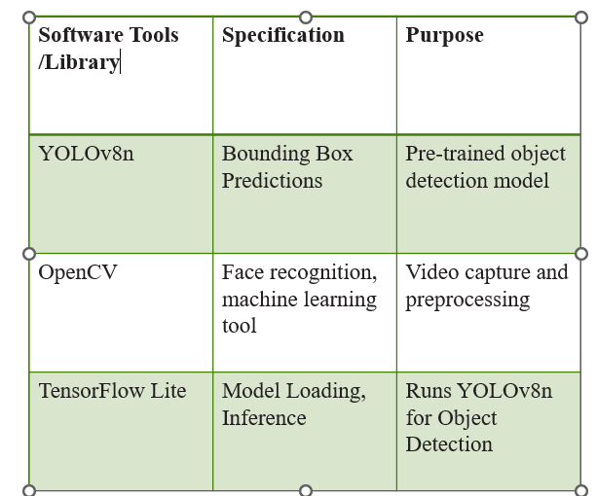
SOFTWARE COMPONENTS

Slide 8
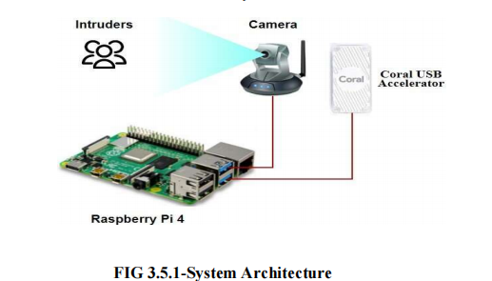
SYSTEM ARCHITECTURE

Slide 9
IMPLEMENTATION
Step 1: Data collection and model training using YOLOv8.
Step 2: Integrating hardware components with Raspberry Pi.
Step 3: Running TensorFlow Lite for real-time inference.
Step 4: Monitoring power consumption with INA219.

Slide 10
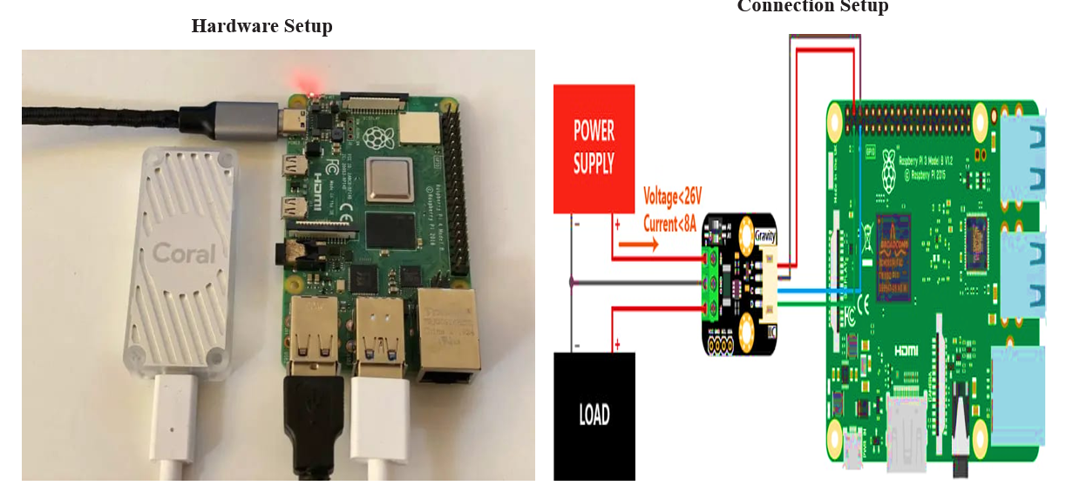
HARDWARE SETUP

Slide 11
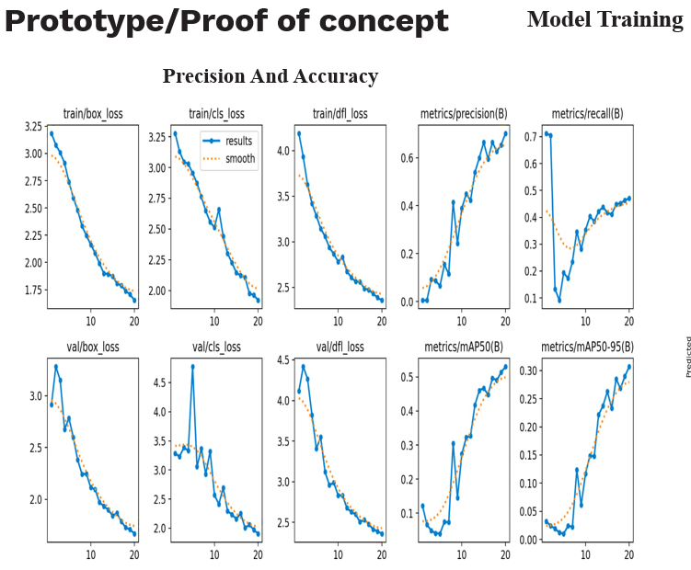
OUTCOMES

Slide 12
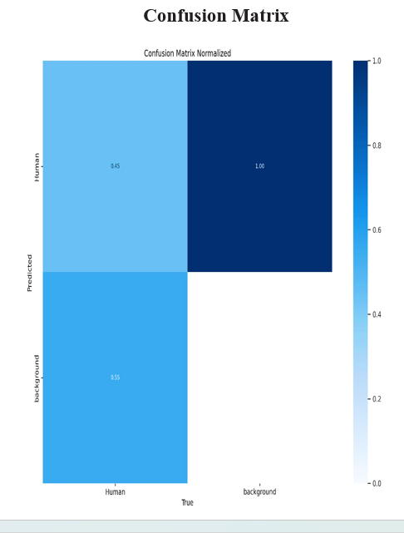

Slide 13
APPLICATIONS
Industrial Automation: Energy-efficient monitoring.
Surveillance Systems: Real-time security.
IoT Devices: Smart cities and home automation.

Slide 14
CONCLUSION
Edge computing is crucial for real-time AI.
Energy-efficient accelerators reduce power and latency.
Successful implementation with potential real-world applications.

Slide 15
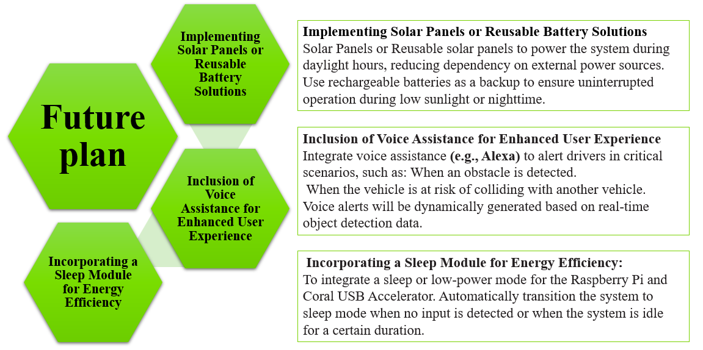
FUTURE SCOPE

